Slide 1
Big Mountain Resort
Ticket Price Analysis
Ricardo Cepeda

Slide 2
Problem Identification
Big Mountain suspects it may not be maximizing its returns relative to its position in the market.
The current ticket price is $81.00
The project aims to:
Get a strong sense of what facilities matter most to visitors.
Build a predictive model for a new ticket price.
This model will guide Big Mountain’s pricing and future facility investment plans.

Slide 3
Recommendations
Key findings
Raw data contained some ticket price values, but several missing values led to some rows being dropped altogether.
There were two kinds of the ticket price (AdultWeekday, AdultWeekend)
Data augmentation - US state population and size
Strong positive correlation with:
vertical_drop
fastQuads
Runs
total_chairs
Snow Making_ac

Slide 4
Modeling Results
Analysis
Top four features common in Linear and Random Forest models:
fastQuads
Runs
Snow Making_ac
vertical_drop

Slide 5
Performance
 | Linear Regression Model | Random Forest Model
Mean Absolute Error (MAE) Mean | 10.499 | 9.644
Mean Absolute Error (MAE) Std. Deviation | 1.622 | 1.353
Mean Absolute Error | 11.793 | 9.537

Slide 6
Final Model Selection
The Random Forest Model has the lowest cross-validation mean absolute error (MAE) by almost $1.00.
It also exhibits less variability.
Verifying performance on the test set produces performance consistent with the cross-validation results.

Slide 7
Modeling Scenarios
Permanently clossing down up to ten of the least used runs.

Slide 8
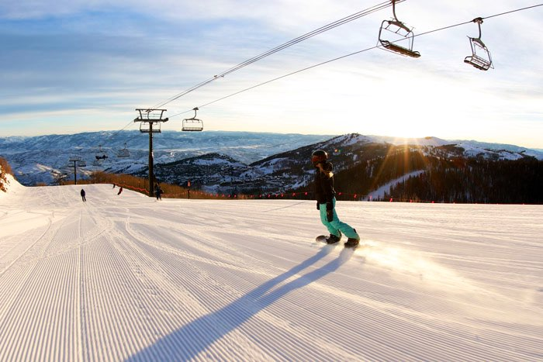
Increase the vertical drop by adding a run to a point 150 feet lower down but requiring the installation of an additional chair lift to bring skiers back up without additional snow-making coverage.

Slide 9
Summary
Conclusion
Big Mountain Resort's modeled price is $95.87; the actual cost is $81.00.
Even with the expected MAE of $10.39, this suggests more room for an increase.
Keep in mind that the model's validity lies in the assumption that other resorts set the prices accurately according to what the market supports.

